Slide 1
Business Model & Operation Model in Online Platform Design
Judy Wang
May 15 2019

Slide 2
Customer Journey
Online Ads
Tele-Marketing
Trial session & level placement
Select package & purchase
Re-purchase
Evaluate the session
Experiencing the session
Book a session
Set up topic of interest

Slide 3
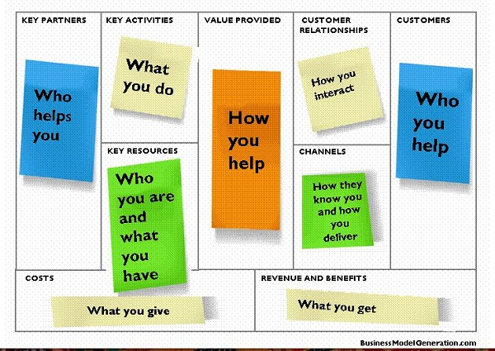
Business model
Online Ads
Tele-Marketing
Trail session & level placement
Select package & purchase
Re-purchase
Evaluate the session
Experiencing the session
Book a session
Set up topic of interest

Slide 4
Business model - 人人都需要學英文 但是他們主打的是什麼族群？
Online Ads
Tele-Marketing
Trail session & level placement
Select package & purchase
Re-purchase
Evaluate the session
Experiencing the session
Book a session
Set up topic of interest
激勵制度薪資（rating)
成人 連交通時間都抽不出來學英文的那種
招募與訓練老師
最好是在家裡就可以學 而且 24x7
教材規劃與製作
已經有點基礎 只是苦無練習的機會
排課系統（學生興趣等級與教材媒合）
只想加強自己有興趣的主題
教學（通訊） 平台
注重口說 純正英美口英或是多元口英
數位行銷＋電話行銷＋線上交易＋客服電話中心的平台

Slide 5
What about “Gaming coach platform “ ?
?
?
?
?
?
?
?
?
?
?
?
?
?
?

Slide 6
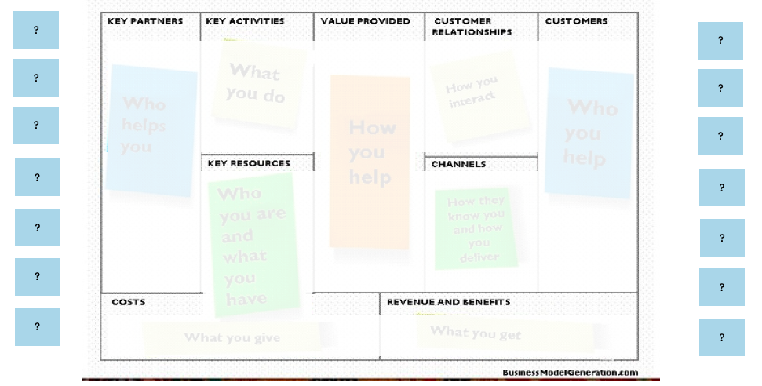
How will that business model construct a customer journey ?

